Slide 1
ISDN, GSM, GPRS and CN
Notes:
Let’s have a tour of some advanced technologies such as ISDN …GSM …GPRS and TCP/IP

Slide 2
Objectives
At the end of this session, you will be able to:
  Understand ISDN network from a perspective of network components and different ISDN flavor of services
  Understand the concept of cell and impact of cell size in GSM
  Understand frequency reuse concept in GSM
  Understand GSM network evolution, network architectural composition and GSM identifiers
  Understand the steps followed in Mobile registration, mobile originated call [MOC] and mobile terminated call [MTC]
  Understand the concept of roaming in GSM
  Understand GPRS network enhancement on the top of GSM
  Understand the role of SGSN and GGSN in GPRS network
  Understand the features of GPRS network
  OSI and TCP/IP protocols, devices and addresses
  Understand the logical and physical representation of internet today
  Understand the dataflow transfer in computer network with applications of mail transfer
CONFIDENTIAL© Copyright 2008 Tech Mahindra Limited

Slide 3
Agenda
ISDN network: features, network, flavors
GSM Network: Cell size and its impact
GSM Network architecture
GSM identifiers
GSM call scenarios: Mobile registration, MOC and MTC
GPRS network architecture
Computer Network: LAN, MAN, WAN
OSI and TCP/IP protocol
Networking devices and addresses
Internet: Physical layout
Client and Server: Mail protocol example
CONFIDENTIAL© Copyright 2008 Tech Mahindra Limited

Slide 4



ISDN
Fax
Basic Rate
access
Primary Rate
access
WHY ISDN?
What is ISDN?
I : Integrated S : Services
D: Digital N : Network
ISDN is a High speed, Fully digital, Telephone service; Easily controllable and configurable End to End Digital service in PSTN
All at the COST of a bit more MONEY
(group 4)
Network
Terminal
NT2
2B+D
NT1
N - ISDN
30B+D
PBX
Passive
bus
PSTN
TA
Terminal
adapter
PSPDN
CONFIDENTIAL© Copyright 2008 Tech Mahindra Limited

Slide 5
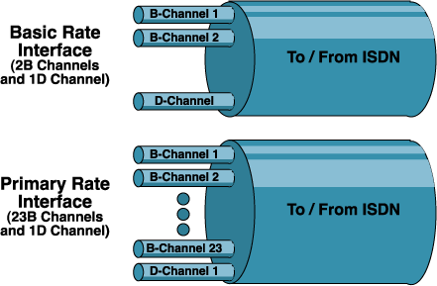
ISDN Flavors (Interfaces)
Basic Access consists of two full-duplex 64Kbps B Channels and a full-duplex 16 Kbps D channel. (2B + 1 D)
The total bit rate is 144 kbps.
Framing synchronization, and other overhead bits bring the total bit rate on a basic access link to 192 Kbps.
Primary Access is intended for users with greater capacity
In US and Japan, (23 B + 1 D) 1.5 Mbps is the standard rate i.e. T1
In Europe, (30B +1 D + 1 Sync ) = 2.048 Mbps is the standard rate i.e. E1
CONFIDENTIAL© Copyright 2008 Tech Mahindra Limited
Notes:
======
The basic service is intended to meet the needs of most individual users, including residential subscribers and very small offices.
It allows simultaneous use of voice and several data applications, such as internet access, a link to central alarm service, facsimile, teletex and so on.
These services could be accessed through a single multifunction terminal or several separate terminals.
In either case, a single physical interface is provided. Most existing two-wire local loops can support this interface.
Primary Access is intended for users with greater capacity requirements, such as
offices with a digital PBX or a LAN.
The U.S., Canada, and Japan makes use of a transmission structure based on
1.544 Kbps; this corresponds to the T-1 transmission facility of AT&T.
In Europe, 2.048 Mbps is the standard rate, both of these data rates are provided as
a primary interface service.
Typically, the channel structure for the 1.544 Mbps rate will be 23 B channels plus
one 64 Kbps D Channel and the 2.048 Mbps rate, 30 B Channels plus one 64 Kbps
D Channel.
It is possible for a consumer with lesser requirements to employ fewer B Channels,
in which case the channel structure is nB+D, where n ranges from 1 to 23 or from 1
to 30 for the two primary services.
A customer with high data rate demands may be provided with more than one
primary physical interface.
In this case, a single D channel on one of the interfaces may suffice for all signaling
needs, and the other interfaces may consist solely of B Channels ( 24B or 31 B).
The primary interface may also be used to support H Channels.
Some of these structures include a 64 Kbps D Channel for control signaling. When
no D channels are present, it is assumed that a D channel on another primary
interface at the same subscriber location will provide any required signaling.

Slide 6
ISDN Interfaces
Fax
Basic Rate
access
Primary Rate
access
(group 4)
Network
Terminal
2B+D
N - ISDN
30B+D
NT2
NT1
PBX
Passive
bus
PSTN
TA
Terminal
adapter
PSPDN
CONFIDENTIAL© Copyright 2008 Tech Mahindra Limited
Notes:
Terminal Equipment refers to subscriber equipment that makes use of the ISDN.
Terminal Equipment Type 1 (TE1) refers to devices that support the standard ISDN interface.
Terminal Equipment Type 2 (TE2) encompasses existing non-ISDN equipment. Such equipment requires a terminal adapter (TA) to plug into an ISDN interface.
NT2 so called Network terminator 2 is a customer premises switching equipment installed by service provider at customer premises.
NT1 (subscriber line terminator) …

Slide 7
Wireless World - GSM and GPRS
Notes:
Let’s move onto GSM and GPRS which almost everybody of us are familiar with ….

Slide 8
Cellular Implementations Wireless Mobile History
First-generation (1G):
  Analog cellular systems ( 450-900 MHz)
  FDMA for spectrum sharing
  NMT (Europe), AMPS (US)
Second-generation (2G):
  Digital cellular systems ( 900MHz, 1800 MHz)
  TDMA/FDMA/CDMA for spectrum sharing
  Circuit switching in wireless
  GSM (Europe), IS-136 (US), PDC (Japan)
2.5G: Packet switching extensions
  Voice + Data
  Digital: GSM to GPRS
3G:
  High speed and real time data services
  IMT-2000
CONFIDENTIAL© Copyright 2008 Tech Mahindra Limited
Notes:
1G systems (analogue) : TACS (UK), AMPS (USA)
2G systems (digital) : GSM (Europe), TDMA (USA)
2½G systems : GPRS (Europe)
3G systems : UMTS (Europe), CDMA 2000 (USA), TD-SCDMA (China)
aiming for a global standard to allow worldwide roaming but unlikely to happen

Slide 9

Conventional Mobile Phone Service
CONFIDENTIAL© Copyright 2008 Tech Mahindra Limited
Notes:
Cellular Concept: Motivation
Early mobile radio systems used to have large coverage with single, high-powered transmitter.
Because of the finite spectrum allocation to an operator and no frequency re-use due to interference limits the customer base.
Need was : High capacity i.e. more number of users with limited spectrum as well as wide coverage.
And the Solution was Cellular mobile …i.e. divide large area into smaller cells

Slide 10


Cellular Telephone Service: Mobile- to-Mobile
MTSO
Cell
Cell
Cell
Cell
Base Station
PTC _ PITA Telecoms Conference & Exhibition
CONFIDENTIAL© Copyright 2008 Tech Mahindra Limited

Slide 11

Cellular Radio – Infinity illusion
A combination of SDM, FDM and TDM
Two separate frequency bands used for Tx and Rx
Sender and receiver sequences shifted by 45MHz and 3 time slots
Predefined time slot for signaling channel
Each communication 200 Khz uplink and 200Khz downlink
Ideally, 3 different frequency sets are sufficient
CONFIDENTIAL© Copyright 2008 Tech Mahindra Limited

Slide 12

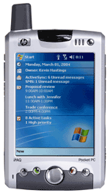
GSM Uplink Downlink
UPLINK
DOWNLINK
890MHz
915MHz
935MHz
960MHz
0
124
0
124
  GSM900 : 880 - 915 MHz paired with 925 - 960 MHz
  GSM1800 : 1710 - 1785 MHz paired with 1805 - 1880 MHz
  GSM1900 : 1850 - 1910 MHz paired with 1930 - 1990 MHz
CONFIDENTIAL© Copyright 2008 Tech Mahindra Limited

Slide 13
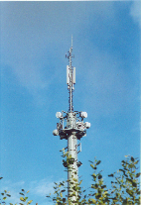
2G Mobile: Frequency Split
MTSO
Fre. 13,14,15
Fre. 1,2,3
Cell
Fre. 10,11,12
Fre. 4,5,6
Fre. 4,5,6
Base Station
Fre. 7,8,9
PTC _ PITA Telecoms Conference & Exhibition
CONFIDENTIAL© Copyright 2008 Tech Mahindra Limited

Slide 14
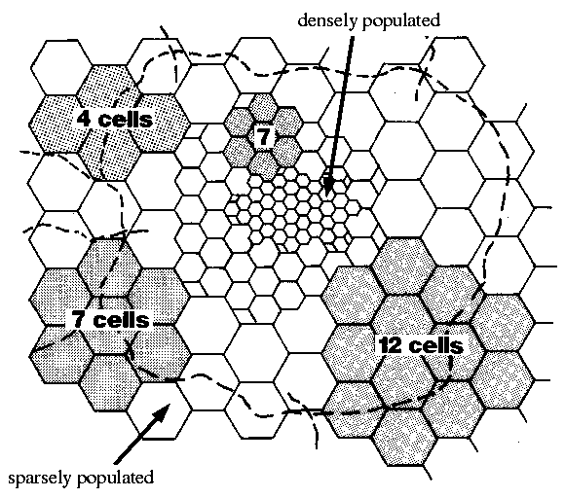
Cell Size
CONFIDENTIAL© Copyright 2008 Tech Mahindra Limited

Slide 15
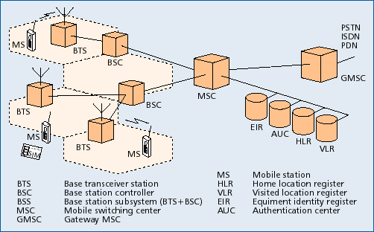
GSM: System Architecture
CONFIDENTIAL© Copyright 2008 Tech Mahindra Limited
Notes:
Gateway Mobile Services Switching Center ( GMSC)
Point of call entry into the PLMN (for calls terminating in this network from PSTN or other mobile network)
Mobile Switching Center / Visitor Location Register (MSC/VLR)
Usually integrated in one box
High Capacity Switch
Works like a normal exchange
Responsible for
Setting up & controlling voices calls & SMS
Handover & Location Update
Charging and accounting
Base Station Controller (BSC)
Handles all BTS under observation
Manages the radio network and handover from one cell to another
Base Transceiver Station (BTS)
Responsible for sending and receiving radio signals to / from mobiles
Quality Measurements and Power Control
Mobile Station (MS)
Two parts
Mobile Equipment = Phone instrument
SIM card = Subscriber Identity Module, a smart card
Home Location Register (HLR)
Database that stores and manages subscription related information
Semi-Permanent Data
Mobile number, SIM number, services
Dynamic Data
VLR identity, active services like forwarding
Authentication Center (AuC)
Database of authentication keys , ciphering keys and algorithms for both authentication and ciphering
one record per SIM card
Equipment Identity Register (EIR)
Maintains Mobile Equipment’s serial number
In terms of
Black List
Grey List
White List
ExTRA Notes
=======
GMSC
Gateway Mobile Services Switching Center
Like a normal exchange
Point of call entry into the PLMN (for calls to mobile)
Interrogates HLR for identifying current location of the mobile
Routes call to the MSC where the mobile is present
Has charging and accounting functions built
MSC/VLR
Mobile Switching Center / Visitor Location Register
Usually integrated in one box
Like a normal exchange
Responsible for
Setting up & controlling calls including SS & SMS
Handover & Location Update
Controlling the BSC
Equipment Identity Control
Charging and accounting
BSC
Base Station Controller
Handles all BTS
Manages the radio network
Manages connectivity to Mobile stations including handovers
Administers the BTS & the radio characteristics
Works like a remote unit (slave-switch) of the MSC/VLR
BTS
BTS stands for Base Transceiver Station
Radio equipment responsible for sending and receiving radio signals to / from mobiles
Quality Measurements
Power Control
Broadcasting system information & paging
Receiving channel requests from mobile
Implements radio hopping
MS
Mobile Station
Two parts
Mobile Equipment = Phone instrument
SIM card = Subscriber Identity Module, a smart card
Radio equipment
Signaling and speech coding
signal strength measurements
Power Control
HLR
Home Location Register’
Database that stores and manages subscription related information
Semi-Permanent Data
Mobile number, SIM number, services
Dynamic Data
VLR identity, active services like forwarding
Handles interrogation for locating a mobile
Charging function
Authentication of access
AuC
Authentication Center
Database of authentication keys and authentication algorithms
Contains one record per SIM card
Generates a random number, a ciphering key (for encryption) and a signed response
Authentication is performed in MSC
Ciphering is performed by the BTS
Implementations vary
EIR
Equipment Identity Register
Maintains Mobile Equipment’s serial number
Maintains three lists
Black List
Grey List
White List
Consults the lists and returns information of which list the mobile is on
Used for controlling calls from stolen mobiles and faulty mobiles

Slide 16
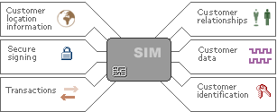

GSM Identifiers
MSISDN
  Mobile Station ISDN number
  Number that can be dialed from a mobile/telephone
  Country Code (CC) + Network Destination Code (NDC) + Subscriber Number (SN)
IMEI
  International Mobile Equipment Identity
  Unique identity of hand-set
LAI
  Location Area Identity
  Key element for location update
IMSI
  International Mobile Subscriber Identity
  Unique identity of a SIM card / subscription
  Mobile Country Code (MCC) + Mobile Network Code (MNC) + Mobile Subscriber Identification Number (MSIN)
  The key field for billing
TMSI
  Temporary Mobile Subscriber Identity
  Security mechanism
  Avoids usage of IMSI as an identity over the air
  Allocated by MSC
CONFIDENTIAL© Copyright 2008 Tech Mahindra Limited
Notes:
IMEI : Type Approval Code (TAC) + Final Assembly Code (FAC) + Serial Number (SNR) + Software Version Number (SVN)
LAI : Mobile Country Code (MCC) + Mobile Network Code (MNC) + Location Area Code (LAC)
With this we come to an end of GSM network. Now let’s have a look as GPRS network.

Slide 17
Mobile Registration
Wherever you go our Network catches you
Wherever mobile moves, the entry will be registered into the MSC/VLR in context and Pointer to VLR is stored in HLR
In the nutshell, HLR is a single point of contact for every mobile
CONFIDENTIAL© Copyright 2008 Tech Mahindra Limited

Slide 18

Mobile Terminated Call [MTC]
1: calling a GSM subscriber
2: forwarding call to GMSC
3: signal call setup to HLR
4, 5: request MSRN from VLR
6: forward responsible
MSC to GMSC
7: forward call to
current MSC
8, 9: get current status of MS
10, 11: paging of MS
12, 13: MS answers
14, 15: security checks
16, 17: set up connection
4
HLR
VLR
5
8
9
3
6
14
15
calling
station
7
PSTN
GMSC
MSC
1
2
10
10
13
10
16
BSS
BSS
BSS
11
11
11
11
12
17
MS
CONFIDENTIAL© Copyright 2008 Tech Mahindra Limited

Slide 19
Mobile Originated Call [MOC]
1, 2: connection request
3, 4: security check
5-8: check resources (free circuit)
9-10: set up call
VLR
3
4
6
5
PSTN
GMSC
MSC
7
8
Paging is NOT necessary in this call
2
9
1
MS
BSS
10
CONFIDENTIAL© Copyright 2008 Tech Mahindra Limited

Slide 20
Roaming
What happens in Roaming?
  In a roaming scenario, mobile user moves from home network and go in some other operator’s network and wanted to use services [may be incoming or outgoing]
  In such scenarios, based on IMSI , operator would get to know as to which country and which operator a subscriber belongs to
  Roaming network checks whether subscriber is allowed to roam by asking HLR of the home network and seek the information
  If answer received is Yes, then subscriber is allowed else subscriber is denied
What is the difference between National and International roaming?
  National roaming → Operator other than home within a country
  International roaming → Operator other than home outside a country
CONFIDENTIAL© Copyright 2008 Tech Mahindra Limited

Slide 21
GPRS Architecture
2G MS (voice only)
NSS
BSS
Abis
E
PSTN
PSTN
A
B
MS
BSC
MSC
C
GMSC
BTS
VLR
D
Gs
SS7
H
Gb
2G+ MS (voice & data)
Gr
HLR
AuC
Gc
Gn
Gi
PSDN
SGSN
IP
GGSN
BSS Base Station System
BTS Base Transceiver Station
BSC Base Station Controller
NSS Network Sub-System
MSC Mobile-service Switching Controller
VLR Visitor Location Register
HLR Home Location Register
AuC Authentication Server
GMSC Gateway MSC
SGSN Serving GPRS Support Node
GGSN Gateway GPRS Support Node
GSM towards GPRS transition
GPRS General Packet Radio Service
CONFIDENTIAL© Copyright 2008 Tech Mahindra Limited
Notes:
GPRS stands for General Packet radio service. It is overlaid network on already existing GSM network with modification of component for GPRS compliance. With GPRS network , now one can have data services like www , ftp , mail , mms along with traditional GSM services like voice and SMS with GPRS enabled mobile.
GGSN
Serves as the interface to external IP networks which could be TCP/IP or X.25 network which see the GGSN as an IP router serving all IP addresses of the MSs
GGSN stores current SGSN address and profile of the user in its location register
It tunnels protocol data packets to and from the SGSN currently serving the MS
It also performs authentication and charging
GGSN can also include firewall and packet-filtering mechanisms
SGSN
Analog of the MSC in GSM
Routes incoming and outgoing packets addressed to and from any GPRS subscriber located within the geographical area served by the SGSN
Location Register of the SGSN stores information (e.g. current cell and VLR) and user profiles (e.g. IMSI, addresses) of all GPRS users registered with this SGSN

Slide 22
GPRS Architecture
2G MS (voice only)
NSS
BSS
Abis
E
PSTN
PSTN
A
B
MS
BSC
MSC
C
GMSC
BTS
VLR
D
Gs
SS7
H
2G+ MS (voice & data)
Gb
Gr
HLR
AuC
Gc
Gn
Gi
PSDN
SGSN
IP
GGSN
BSS Base Station System
BTS Base Transceiver Station
BSC Base Station Controller
NSS Network Sub-System
MSC Mobile-service Switching Controller
VLR Visitor Location Register
HLR Home Location Register
AuC Authentication Server
GMSC Gateway MSC
SGSN Serving GPRS Support Node
GGSN Gateway GPRS Support Node
GPRS General Packet Radio Service
CONFIDENTIAL© Copyright 2008 Tech Mahindra Limited
Notes:
GPRS stands for General Packet radio service. It is overlaid network on already existing GSM network with modification of component for GPRS compliance. With GPRS network , now one can have data services like www , ftp , mail , mms along with traditional GSM services like voice and SMS with GPRS enabled mobile.
GGSN
Serves as the interface to external IP networks which could be TCP/IP or X.25 network which see the GGSN as an IP router serving all IP addresses of the MSs
GGSN stores current SGSN address and profile of the user in its location register
It tunnels protocol data packets to and from the SGSN currently serving the MS
It also performs authentication and charging
GGSN can also include firewall and packet-filtering mechanisms
SGSN
Analog of the MSC in GSM
Routes incoming and outgoing packets addressed to and from any GPRS subscriber located within the geographical area served by the SGSN
Location Register of the SGSN stores information (e.g. current cell and VLR) and user profiles (e.g. IMSI, addresses) of all GPRS users registered with this SGSN

Slide 23
GPRS Features
Voice + data together
Higher data rate support
Provides connectivity to external packet data networks
Enables many users to share radio resources by dynamic, on-demand, multi-slot allocation
Modification to the GSM air-interface
Addition of new GPRS Support Nodes, SGSN, GGSN
Enables volume-based charging as well as duration based charging
CONFIDENTIAL© Copyright 2008 Tech Mahindra Limited
Notes:
Always on
Circuit switching for voice and packet switching for data

Slide 24
Power of Technology
2G, 2.5G and 3G comparison
GSM/2G
GPRS/2½G
UMTS/3G
High Power
Long Range
Low Power
Short Range
Text
Graphics
Internet
Audio
Video
Multi-channel
Video
Low Data Rate
High Data Rate
CONFIDENTIAL© Copyright 2008 Tech Mahindra Limited
Notes:
Edge : Just after GPRS
1) A method of increasing the data rates on the radio link for GSM 3-4 times increase in data speeds over GPRS claimed
2) Different protocols and behaviour in the Base Station System same packet handling protocols in the core network
3) Introduces a new modulation technique and new channel coding scheme
UMTS (3G)
1) To cope with increasing volumes of traffic
and new capacity-demanding apps such as video streaming & music download
2) Developed as a global standard to assure international roaming
though now unlikely to be universal e.g. USA, China may use different standards
3) A development from GSM and CDMA – also known as W-CDMA
4) Auction of licenses for spectrum
extremely expensive to set up the new infrastructure needed
5) New handsets required : dual purpose handsets – have to be back-operable with GSM
With this we come towards an end of GPRS network. Now let’s have a look at computer network.

Slide 25
Computer Network
Computer Network
  Interconnected collection of Autonomous computers
  Collection: group of computers
  Interconnected: via media - Wired or wireless
  Autonomous: independent
What is main purpose behind it?
  Sharing of information
  Sharing of resources
CONFIDENTIAL© Copyright 2008 Tech Mahindra Limited
Notes:
Autonomous … totally independent …democracy ….every body has equal access

Slide 26
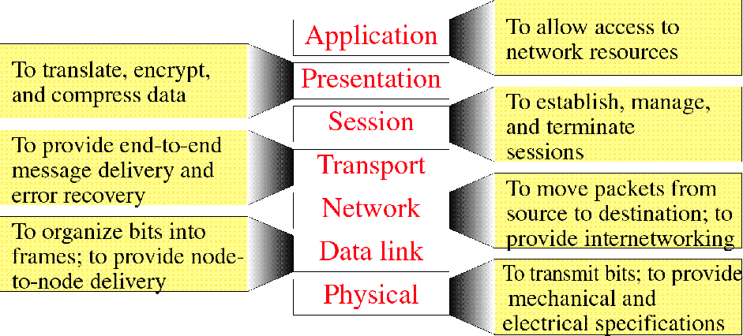
OSI Layer Functions
CONFIDENTIAL© Copyright 2008 Tech Mahindra Limited

Slide 27
Data
Application
Application
Encoded Data
OSI Layer
END To END
Data transfer
process
Presentation
Presentation
Decoded Data
Session
Data
Session
Data
H
Data
Transport
Transport
Data
Network
H
Data
H
H
Data
Network
H
Data Link
H
H
Data
T
Data Link
H
H
Data
Physical
H
Physical
10101000110101
H
H
Data
T
CONFIDENTIAL© Copyright 2008 Tech Mahindra Limited
Notes:
Data Encapsulation
Application Layer - User interacts with the application he is using.
Presentation Layer - User data is encoded.
Session Layer - It transfers the data to transport layer while doing the token control
Transport Layer - It adds its own header and thus data segment is formed
Network Layer - It also adds its own header thus forming the packet
Data link Layer - It adds a header and tailer thus forming frame
Physical Layer - It transmits data in form of stream of bits
Data Decapsulation
Physical Layer – It passes the incoming stream of bits to the data link layer
Data link Layer - It removes the data link header and tailer and passes the packet to the network layer
Network layer - It removes network layer header and passes the data to the transport layer
Transport layer - It removes transport header recognizes the data belongs to which application and passes the data to the session layer
Session layer - It passes the data in encoded form to the presentation layer
Presentation layer- It does the decoding and passes the data to the application layer
Application layer - The user at the application layer receives the data

Slide 28
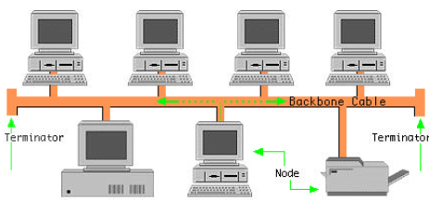
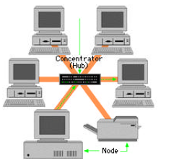

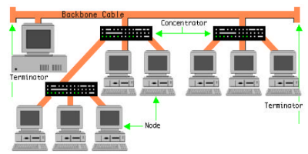

LAN: Topology
Network Topology
Refers to the arrangement or physical
layout of computers, cables and other
components on the network
Standard Topologies
LAN - Bus , Star , Ring , Mesh , Hierarchy
WAN – Mesh and hierarchy
CONFIDENTIAL© Copyright 2008 Tech Mahindra Limited
Notes:
Based on scale and authority , there is a classification of networks called LAN, MAN and WAN
LAN is collection of computers/devices in a small area especially a campus of a company/institute. It has got a single authority for control.
Arrangement of computers/devices is called Network topology.
LAN uses “share a medium” mechanism so demands for protocols as to how to share. Unlike static multiplexing schemes like TDM,FDM etc. LAN uses dynamic multiplexing schemes. Famous amongst them is CSMA/CD ….Polite protocols , democracy – every body has equal right to access , sense for silence before you speak…If you find somebody speaking , abstain from specking .,…characteristics of Politeness. Nevertheless this is not the only protocol.
LAN : Topology used in LAN can be ….BUS ,Ring , Star , Hierarchy ….but preferred ones are star and Hierarchy

Slide 29
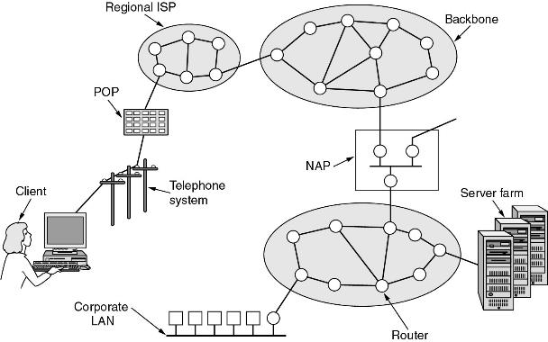
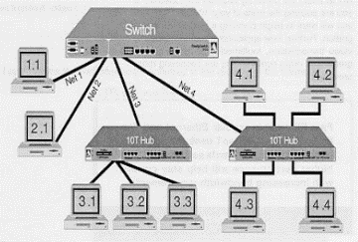
Architecture of the Internet: Physical View
LAN WAN Divide
LAN WAN Divide
CONFIDENTIAL© Copyright 2008 Tech Mahindra Limited
Notes:
WAN is interconnection of LAN with the help of device on the edge of LAN called router. Routers are connected to each other using point to point links and they are arranged in combination of graph and tree to have good amount of redundancy as well as quick transfer by using shortest path.
Interconnection of routers at various hierarchical levels forms the backbone of Internet.

Slide 30
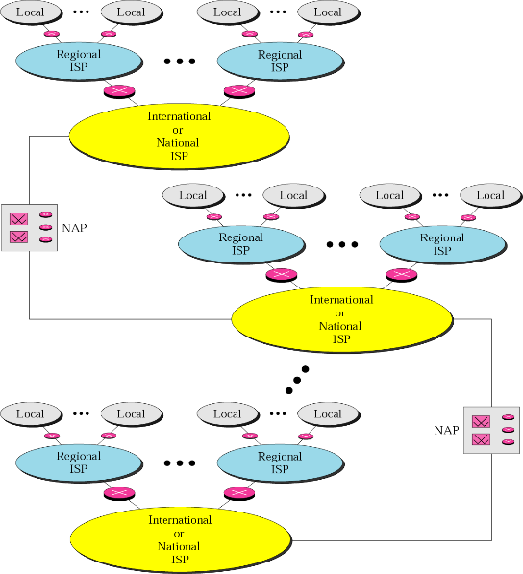


Internet Today
CONFIDENTIAL© Copyright 2008 Tech Mahindra Limited

Slide 31
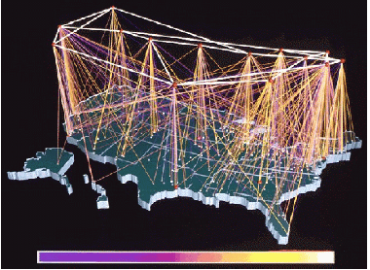
Internet USA Structure
CONFIDENTIAL© Copyright 2008 Tech Mahindra Limited

Slide 32
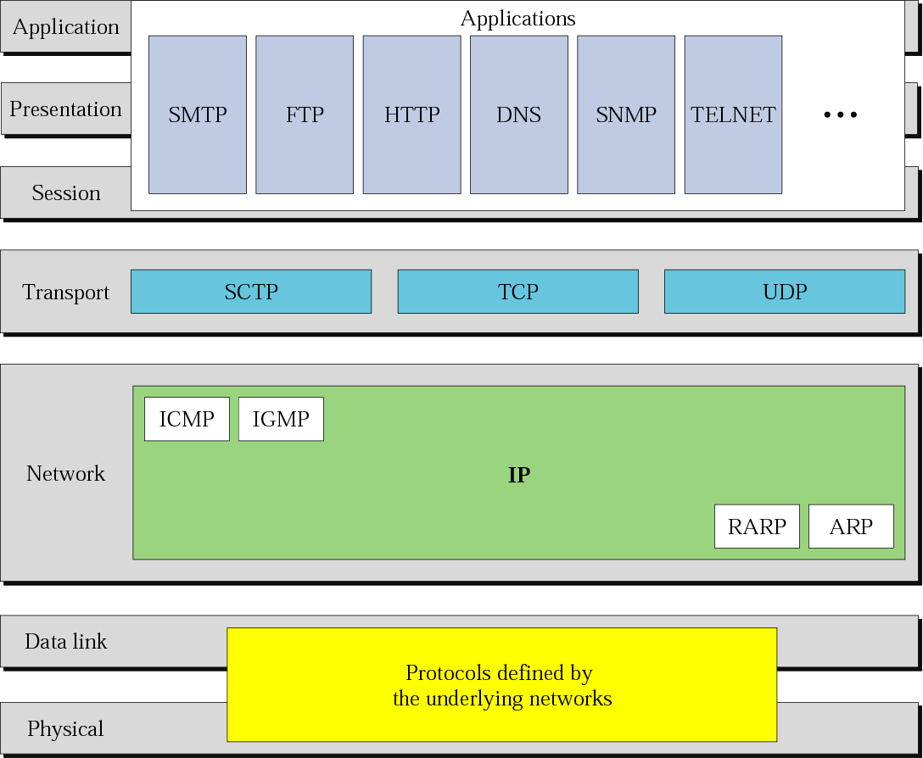
TCP/IP and OSI Model
End Applications
End to end reliable data transfer
Router – Routing and addressing
Framing , error control , flow control and hop-to-hop delivery
Raw bits transmission
CONFIDENTIAL© Copyright 2008 Tech Mahindra Limited
Notes:
When we want two heterogeneous systems to talk with each other there has to be protocol between them.
What is protocol ? Protocols are rules and procedures agreed upon by all parties for communication.
The TCP/IP protocol reference model was used in the ARPANET and is still in use in its successor, the worldwide Internet.
It came to be known as the TCP/IP model after its two primary protocols: TCP and IP. It was first defined in 1974.
It the only language talked on Internet. By the way TCP/IP is not a single protocol but a suite of protocols. As you could see in above diagram at every layer there are certain protocols.
There are other standards/protocols existing.
ISO’s i.e. Indian standard organizations OSI protocol suite
IBM Systems Network Architecture (SNA)
Novell NetWare
Apple's AppleTalk
It is interesting to note that : TCP IP is a real implementation whereas ISO’s OSI is a model and on time line TCP/IP came first.
Application , Presentation and Session layer of OSI are kind of clubbed into one in TCP/IP and is known as application layer.
Functionalities of each layer are as shown in figure.
Presentation : Encryption and compression
Session : Maintain a session between two end entities

Slide 33
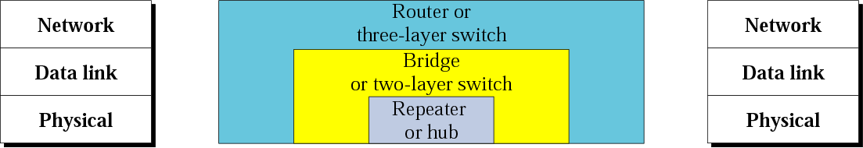
Connecting Devices
Router – Routing and addressing
Bridge/ Layer 2 switch
CONFIDENTIAL© Copyright 2008 Tech Mahindra Limited
Notes:
Router works at layer 3. Its main function is addressing and routing.
Bridge in a multiprotocol router within a LAN. It can understand multiple data link layer protocols.
Repeater and hub are physical layer devices. They do not have much intelegence as routers or switches do have.

Slide 34
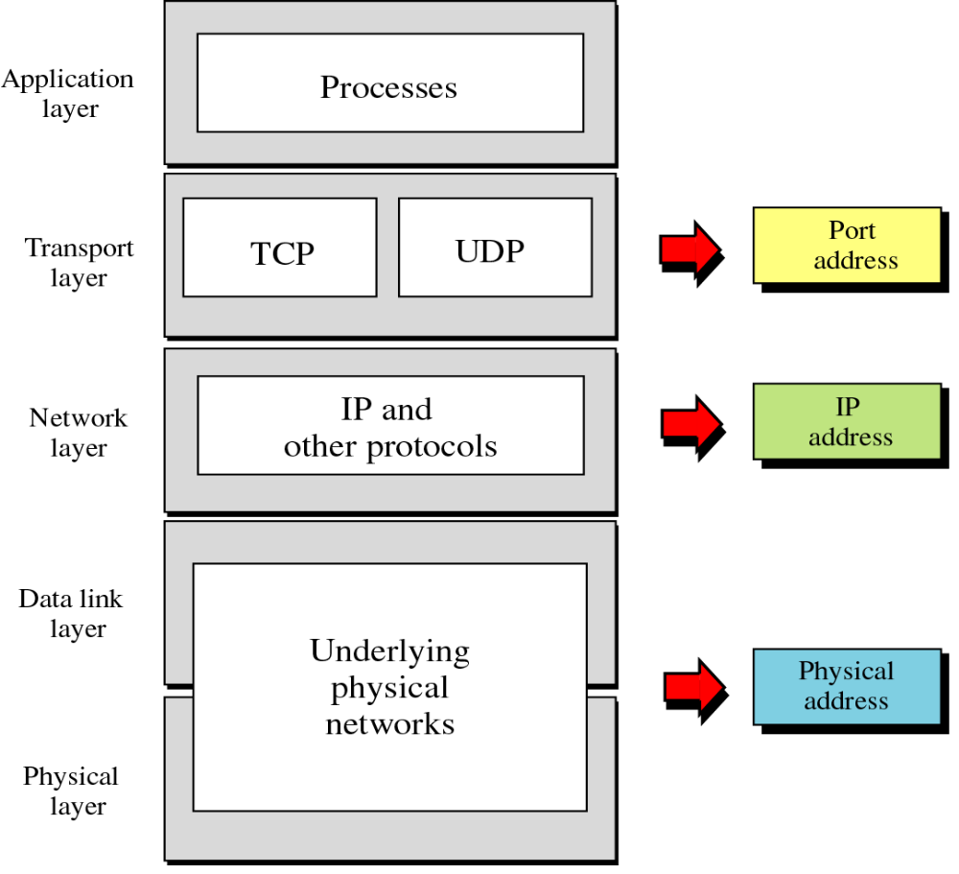
Address and Context
CONFIDENTIAL© Copyright 2008 Tech Mahindra Limited

Slide 35

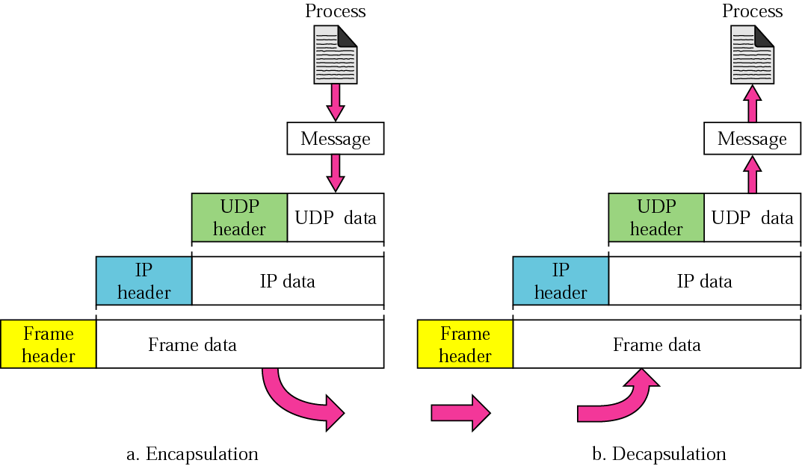
TCP/IP: How Data is Transferred?
data
application
transport
network
link
physical
Router
network
link
physical
application
transport
network
link
physical
data
application
transport
network
link
physical
application
transport
network
link
physical
`
CONFIDENTIAL© Copyright 2008 Tech Mahindra Limited

Slide 36
Client-Server Paradigm
Client:
Initiates contact with server (“speaks first”)
typically requests service from server
Server:
Provides requested service to client.
Always on
application
transport
network
link
physical
Router
Reply
network
link
physical
Request
application
transport
network
link
physical
Typical client-server protocols in Internet: Telnet, FTP, HTTP, POP, SMPT etc.
CONFIDENTIAL© Copyright 2008 Tech Mahindra Limited
Notes:
Typical network app has two pieces: client and server

Slide 37
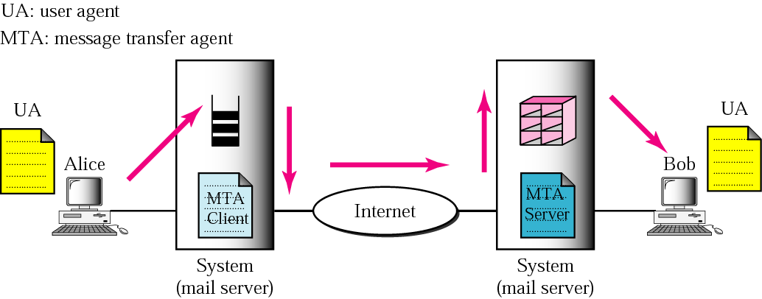
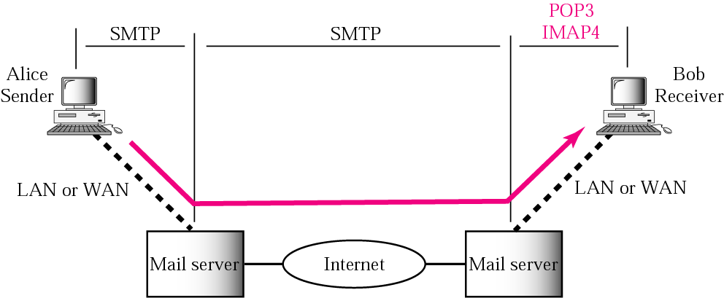
How Mail is Transferred?
CONFIDENTIAL© Copyright 2008 Tech Mahindra Limited
Notes:
Some examples of command-driven user agents are mail, pine, and elm
Some examples of GUI-based user agents are Eudora, Outlook, and Netscape.
Give example of Tech Mahindra server system

Slide 38
Summary
In this session, we have learned:
  ISDN network components and different ISDN services such as PRI, BRI
  Concept of cell and frequency reuse in GSM
  GSM network evolution, network architectural composition and GSM identifiers
  Process of Mobile registration, mobile originated call [MOC] and mobile terminated call [MTC]
  Roaming in GSM
  GPRS network enhancement on the top of GSM
  Role of SGSN and GGSN in GPRS network
  GPRS network features
  OSI and TCP/IP protocols, network devices and addresses
  Logical and physical representation of internet today
  Concept of client and server with example of mail transfer
CONFIDENTIAL© Copyright 2008 Tech Mahindra Limited

Slide 39
Thank you

